Slide 1
INTRODUCTION TO MARKETING
0
Chapter 3
The Cultural
Environment
NGUYEN THI PHUONG*
THANG LONG UNIVERSITY
*MA in Global Marketing, PHD in Economics

Slide 2
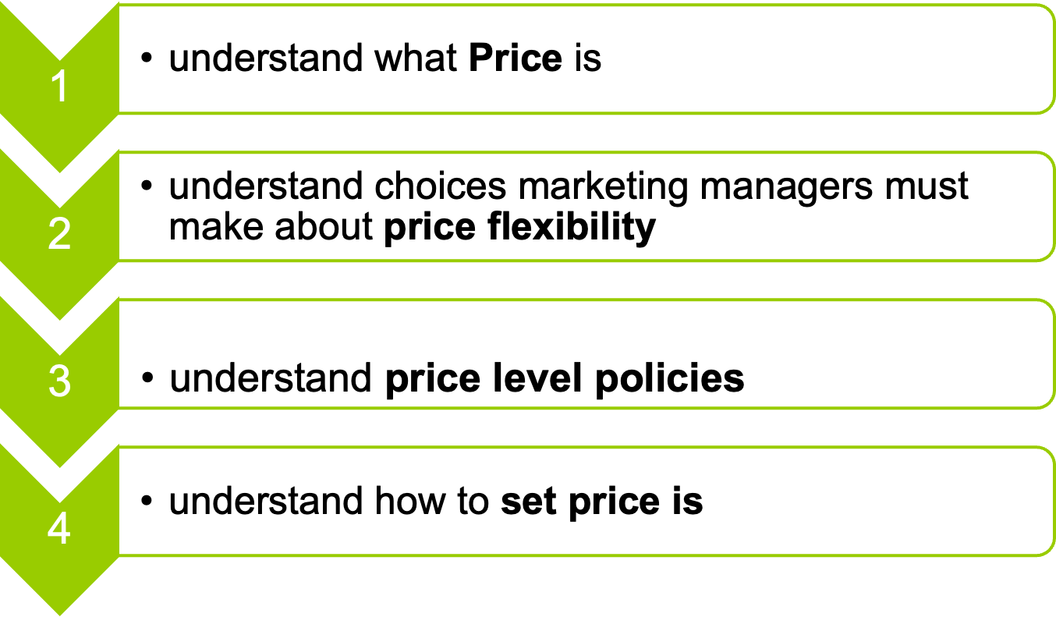
SESSION 10: Pricing
Copyright © 2011 Pearson Education
15-<number>

Slide 3
10.1 What is price?
Pricing decisions affect both the number of sales a firm makes and how much money it earns
Price is what a customer must give up to get the benefits offered by the rest of a firm’s marketing mix so it plays a direct role in shaping customer value.
Price is the amount of money that is charged for “something” of value
tuition fee, rent, room rate, dues, interest
Copyright © 2011 Pearson Education
15-<number>

Slide 4
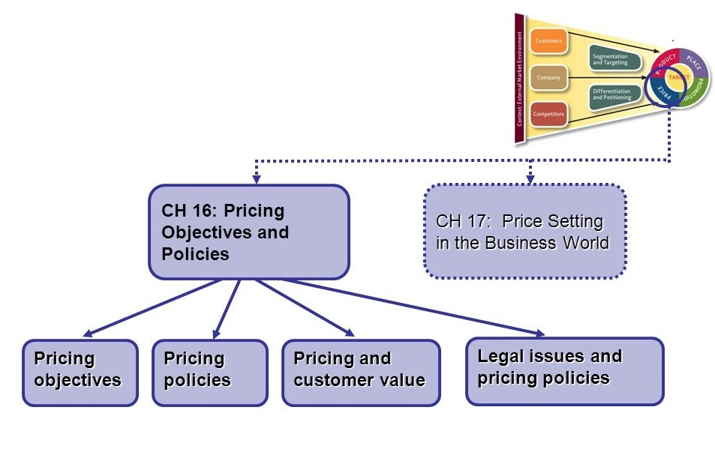
Strategy planning and pricing objectives and policies
Copyright © 2011 Pearson Education
15-<number>

Slide 5
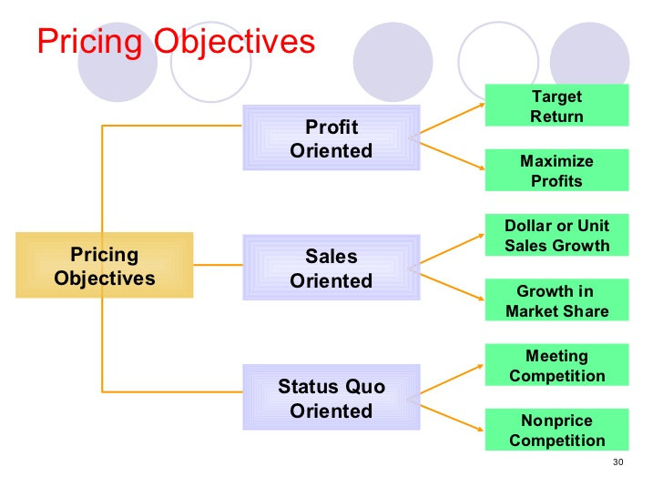
Possible pricing objectives
status quo: giữ nguyên vị trí (trạng thái ngưng trệ)
Copyright © 2011 Pearson Education
15-<number>

Slide 6
10.2 Price flexibility policies
Price policies usually lead to administered prices – consciously set prices. In other words, instead of letting daily market forces (or auctions) decide their prices; most firms set their own prices.
A marketing manager has to use whether a one-price or a flexible-price policy
Copyright © 2011 Pearson Education
15-<number>

Slide 7
A one price policy makes pricing easier but faces with a rigid one price policy (chính sách giá cứng nhắc).
Conventional retailers rigidly applied traditional margins and stuck to them.
A flexible price policy means offering the same product and quantities to different customers at different price. The decisions focus more on what type of customer will get a price break
For example: when supermarket chains give frequent shopper club members reduced prices on weekly specials.
Copyright © 2011 Pearson Education
15-<number>

Slide 8
10.3 Price level policies
Marketing managers who administer prices must consciously set a price level policy. As they enter the market, they have to set introductory prices that may have long-run effects.
A skimming price policy tries to sell the top (skim and scream) of a market – the top of the demand curve – at a high price before aiming at more price sensitive customers
Skimming may maximize profits in the market especially if there are few substitutes or if some customers are not price sensitive.
Copyright © 2011 Pearson Education
15-<number>

Slide 9
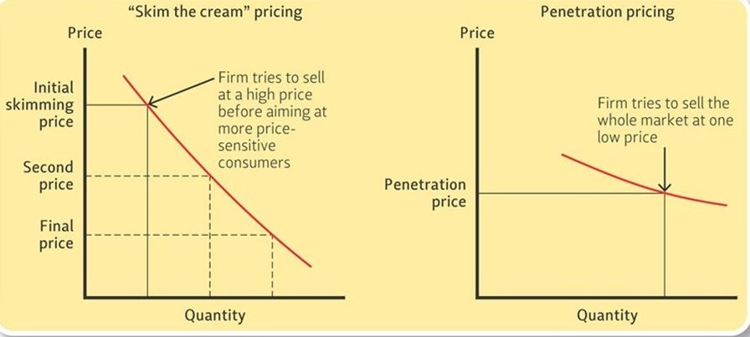
Alternative introductory pricing policies
Copyright © 2011 Pearson Education
15-<number>

Slide 10
A penetration pricing policy tries to sell the whole market at one low price. This approach might be wise when those willing to pay a high price is small. This is the case when the whole demand curve is fairly elastic.
Low prices attract customers. Therefore, marketers often use introductory price dealing – temporary price cuts – to speed new products into a market and get customers to try them.
Copyright © 2011 Pearson Education
15-<number>

Slide 11
10.4 Setting prices
a. Markups guide pricing by intermediaries
Some firms set prices by using a markup-a dollar amount added to the cost of products to get the selling price.
Markups usually stated as percentages rather than dollar amount.
Copyright © 2011 Pearson Education
15-<number>

Slide 12
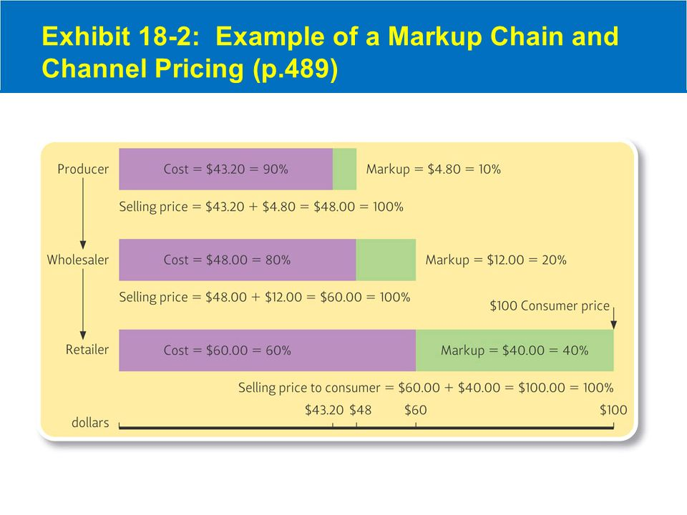
Copyright © 2011 Pearson Education
15-<number>

Slide 13
A standard markup is often set close to the firm’s gross margin.
The gross margin is the amount left-after subtracting the cost of sales from net sales to cover the expenses of selling products and operating the business.
Average cost pricing means adding a reasonable markup to the average cost of a product and focuses on the differences between fixed and variable costs
Copyright © 2011 Pearson Education
15-<number>

Slide 14
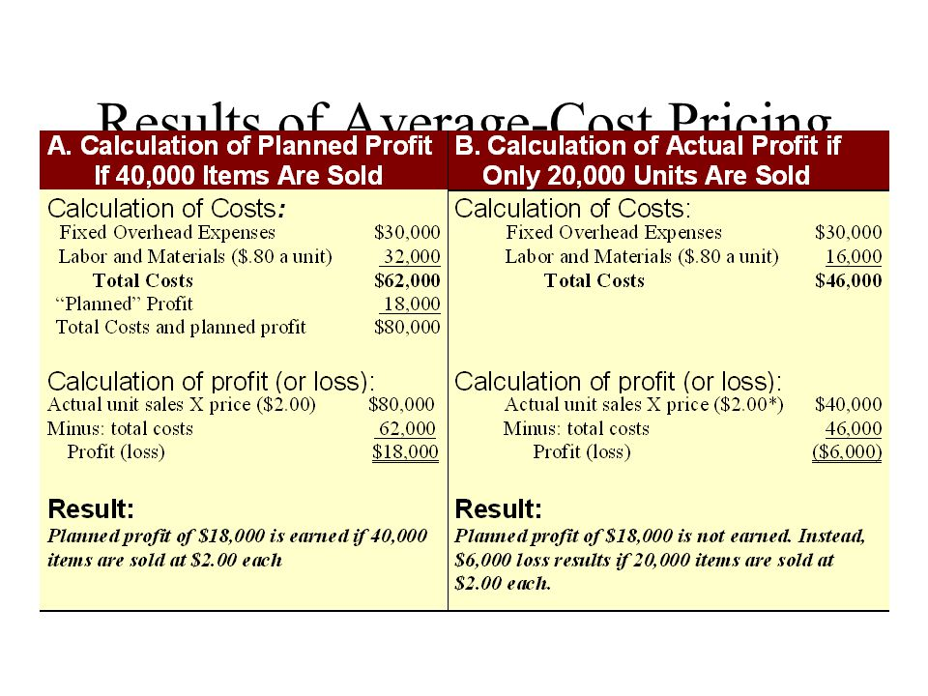
Example of average-cost pricing
Copyright © 2011 Pearson Education
15-<number>

Slide 15
b. Break-even analysis (Phân tích điểm hòa vốn)
Break-even analysis evaluates whether the firm will be able to break even (cover all its costs with a particular price)
This method focuses on the break-even point (BEP)-the quantity where the firm’s total cost will just equal its total revenue (TC=TR)
Copyright © 2011 Pearson Education
15-<number>

Slide 16
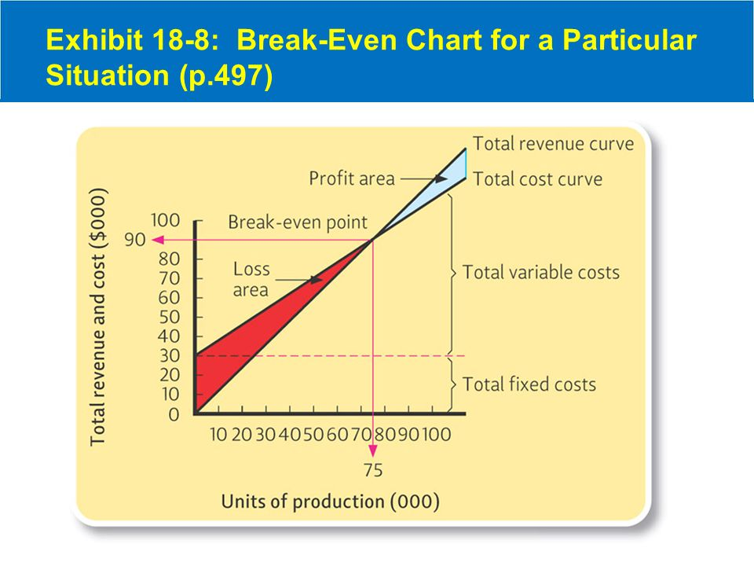
Break-even chart
Copyright © 2011 Pearson Education
15-<number>
Notes:
BEP => TR = TC
P.Q= Fixed cost – Variation Cost
Price* Quantity of sales = Fixed cost + Q.(VC/unit)
Q.(P-VC/unit)=FC => Q= BEP=FC/Fixed Cost per unit

Slide 17

BEP (in units)=
The price per unit is $1.2. The average variable cost per unit is 80 cents. So the Fixed cost contribution per unit is 40 cents. The total fixed cost is $30000=> BEP=75000
Copyright © 2011 Pearson Education
15-<number>

Slide 18
c. Manufacturer’s list price
Leading price: means setting some very low prices-real bargains to get customers into retail stores.
Bait price-giá mồi cầu: is setting some very low prices to attract customers but buying to sell more expensive models or brands once the customer is in the store
Psychological pricing: means setting prices that have special appeal to target customers
Copyright © 2011 Pearson Education
15-<number>

Slide 19
Odd-even pricing: is setting prices that end in certain numbers. For example, products selling ends in the number of 5 or the number of 9 such as 49 cents or $24.95
Price lining: is setting a few price levels for a product line and then marking all items at these prices. For example, many products are priced between $20 and $50 (four levels-$20; $30; $40 and $50)
Copyright © 2011 Pearson Education
15-<number>

Slide 20
Prestige price is setting a rather high price to suggest high quality or high status
Demand-backward pricing is setting an acceptable final consumer price and working backward to what a producer can charge. For example, customers seek a $10 or a $15 gift after spending amount of money
Full-line price: is setting prices for a whole line of products.
Copyright © 2011 Pearson Education
15-<number>

Slide 21
Product-bundle pricing: setting one price for a set of products. Firms set the overall price so that it is cheaper for customers to buy the products at the same time than separately
Bid pricing means offering a specific price for each possible job rather than setting a price that applies for all customers such as auction
Negotiated price: is price set based on bargaining between the buyer and seller
Copyright © 2011 Pearson Education
15-<number>

Slide 22
Homework
1. Identify the strategy decisions a marketing manager must make in the Price area. Illustrate your answer for a local retailer
2. Distinguish between one-price and flexible-price policies. Which is most appropriate for a hardware store? Why?
3. The company’s fixed costs for the year are estimated at $200,000. Its product sells for $250. The variable cost per unit is $200. Sales for the coming year are expected to reach $1250000. What is the BEP? Expected profit?
Copyright © 2011 Pearson Education
15-<number>
Notes:
Total FC: 200.000
VC/unit : 200
Price : 250
Total VC: 1.000.000
Expected sales (Total Revenue): 1.250.000
Quantity Sales expect: 5.000
Total cost of Sales - expected 1.200.000
Profit expected 50.000
FC/unit 40
TC per unit 240
BEP = Total cost of Sales/Price 4.800

